Slide 1

Delivery Costs and Timeline
How to bring us forward!

Slide 2
Delivery Costs
|

Slide 3

What Affects Delivery Costs?
Costs vary based on:
Shipping method: standard, express, urgent, 24h
Destination country or region
Which website was used (Mango.com or Mangooutlet.com)
❗ Always confirm the shipping country selected at checkout. 🔄 Check the website frequently—rates can change!
|

Slide 4

Free Shipping – When Is It Available?
Free shipping is typically offered when:
The order exceeds a minimum value (threshold varies by country)
Delivery is to a collection point (drop point) or Mango store
Drop point: lower cost to encourage sustainable delivery
Store pickup: always free and allows for quicker, low-cost handling
Exceptions:
Express, urgent, and 24h deliveries are usually never free
Promotional codes apply to items only, not shipping fees
Gift cards cover the entire order total, including shipping
.

Slide 5
Cost Disputes & Shipping Policy Limitations
Each order is processed separately—orders can't be grouped
If a customer says a shipping cost seems wrong: ✅ Ask where they ordered: Mango.com or Mangooutlet.com ✅ Check the "Help" section of that site ✅ If it's a confirmed issue, escalate to Ebusiness for review and refund

Slide 6
Delivery Period
|

Slide 7
What Affects Delivery Times?
Delivery time depends on:
Shipping method (standard, express, 24h)
Destination location
Website (Mango.com vs Mangooutlet.com)
Other key variables:
Sales and promotional periods (e.g., Black Friday, Private Sales)
Holiday season spikes (e.g., Christmas)
Logistical disruptions (e.g., warehouse changes, strikes)
📅 Delivery times are calculated in working days (Mon–Fri), unless noted otherwise
|

Slide 8
Realistic Expectations & Delays
Customer Promise = delivery estimate shown at checkout
This is the official timeline we refer to
Can be reviewed in the Order > Delivery tab in internal tools
Weekend deliveries:
Only available in select countries (e.g., UK on Saturdays)
Shown clearly on the website during purchase
Important:
Always say: “The delivery time you see during checkout is the most accurate estimate.”
.

Slide 9
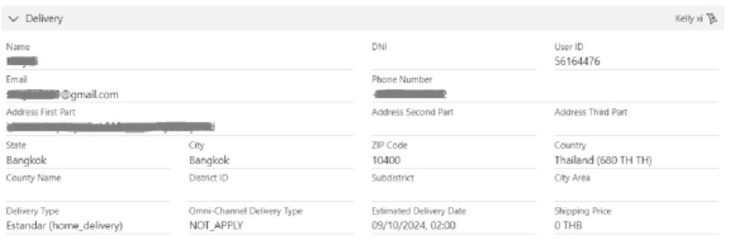
Case Example
We can consult this estimated delivery date that was communicated when making the
purchase (what we internally call “Customer Promise”), in the “Order > Delivery” tab of the
Once the order has been placed, it is not possible to prepare or send the order faster or modify
the type of shipping selected from standard to express or urgent, or speed it up in any way,
since the management is carried out through a fully automated system.
|

Slide 10
Summary & Reminders
Always confirm the correct site (Mango.com or Mangooutlet.com)
🔹 Use checkout info and Help section as the official source
🔹 Escalate only after verifying with the website
🔹 Communicate clearly: base your replies on the customer's actual purchase path
|

Slide 11

Let´s be brilliant together!
Quality and Training Team Mango and Transcom,
April 2025
|

